Slide 1

KIVA LOAN DELAYS
CAPSTONE PROJECT II

Slide 2
PROBLEM STATEMENT
The goal is to understand what are the reasons that are causing higher delays between the time someone has posted a loan to the time it gets funded by the lenders and the time when it gets disbursed to the borrower

Slide 3
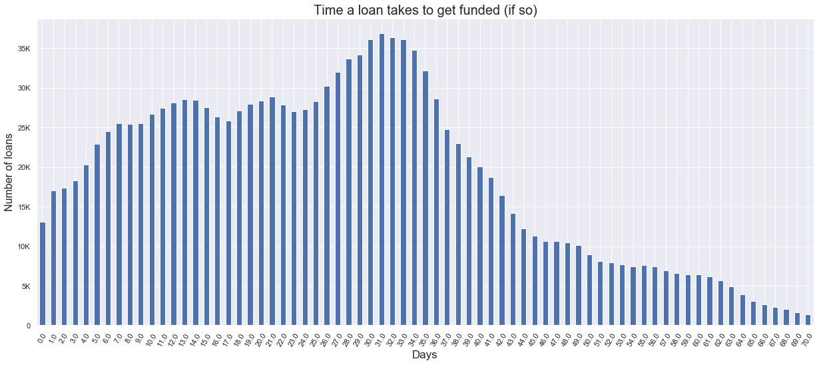
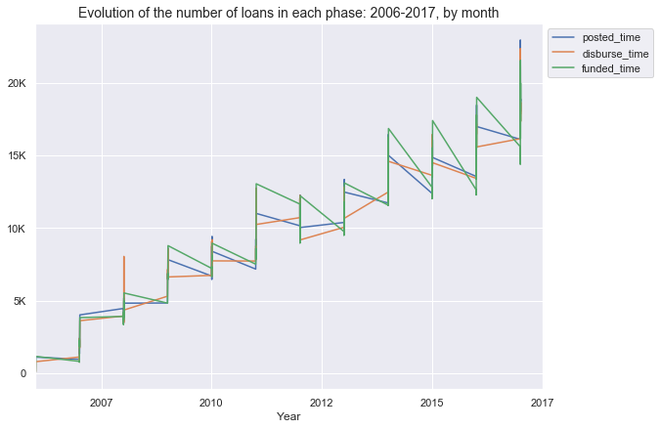
EXPLORATORY DATA ANALYSIS
Nearly 60% of loans are funded with in a month and 95% of loans are funded in two months

Slide 4
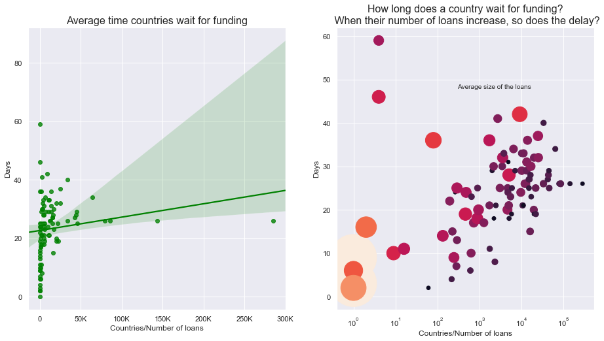
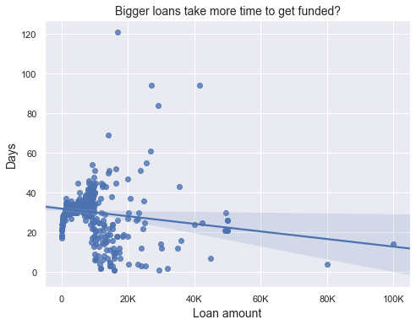
EXPLORATORY DATA ANALYSIS
COUNTRIES WAIT TIME
LOAN AMOUNT vs DELAY

Slide 5
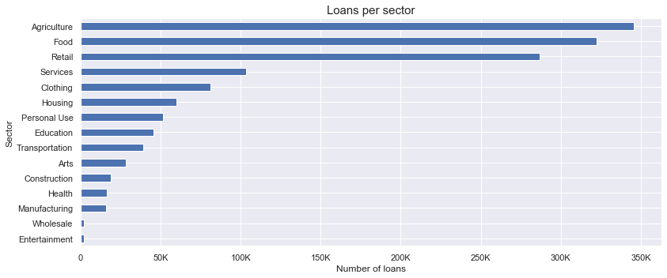
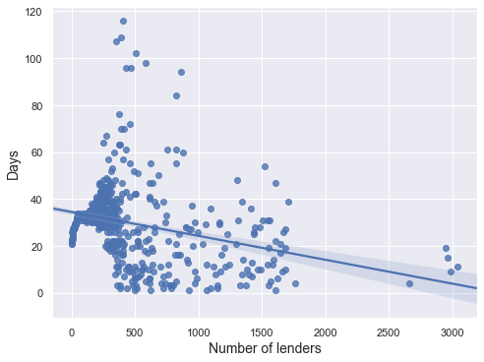
EXPLORATORY DATA ANALYSIS
SECTORS vs LOANS NUMBER OF LENDERS

Slide 6
MODEL AND FEATURE SELECTION
Model: Considering it a classification problem
Classification Problem : “high” vs “low” delay
“high” loan delay | 1 : loan that takes more than 26 days to get funded
“low” loan delay | 0 : loan that takes less than or equal to 26 days to get funded
FEATURES:
Countries: Main 50 countries (97% of the data) → remaining countries into “country_name_other”
Partners: Main 100 partners (85% of the data) → remaining partners into “partner_id_other”
Currency: Main 25 currencies (90% of the data) → remaining currencies into “currency_other”

Slide 7
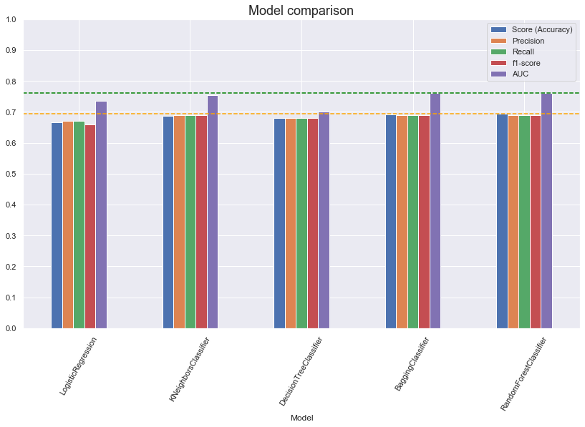
MODEL RESULTS

Slide 8
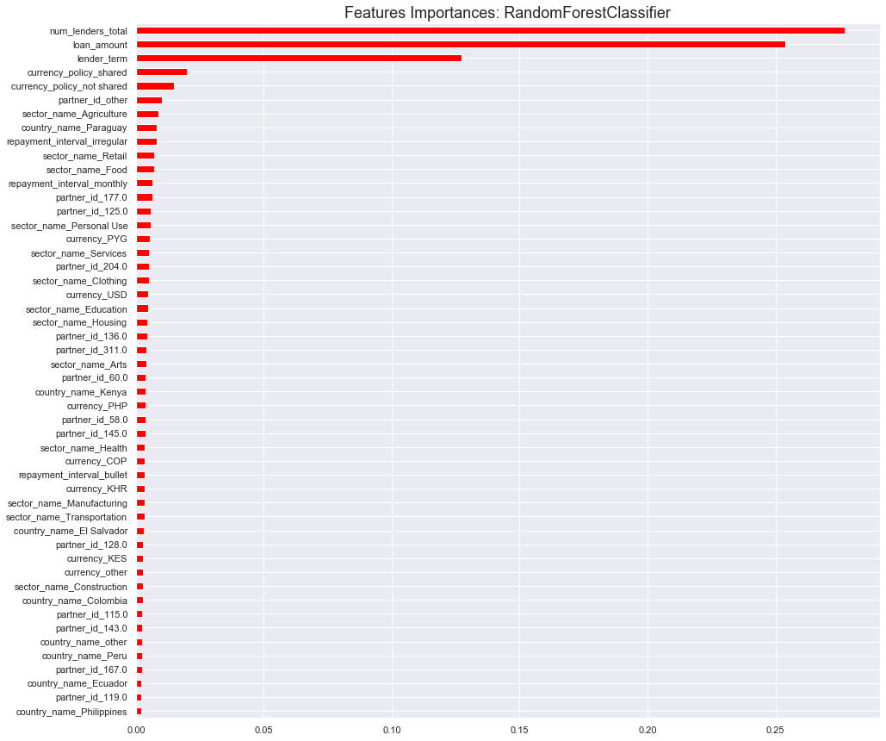
IMPORTANT FEATURES FOR LOAN DELAY
1.NO. OF TOTAL LENDERS
2. LOAN AMOUNT
3. LENDER TERM
4. CURRENCY POLICY SHARED
5. PARTNER ID

